Slide 1

CROWD VISION
Team : Lannisters
Bannari Amman Institute of Technology Sathyamangalam

Slide 2
Harish Raj S
(7376212CB120)
Team Members
Nikitha E
(7376212AD168)
Ram Pranav L G
(7376212AD179)
Abilash S
(7376212CB111)

Slide 3

Crowd Monitoring and Safety Alert
People going to cities have a hard time finding which place is the most suitable and less crowded for them to stay and spend time
Problem

Slide 4

To moniter crowd in public place to get the exact number of people present in that area at any time
Objectives
Suggest the most suitable places to people traveling from rural area

Slide 5

LIVE COUNT
AUTO SUGGESTION OF NEARBY PLACES
SOLUTION
CRIME RATING
FUTURE CROWD PREDICTION

Slide 6


How it Works ?
How it Works
Live feed from the cameras is processed by using Computer Vision technology, which is using trained models
From the processed data the live count of the people is shown

Slide 7
OPEN CV
The CCTV Cameras in public places are integrated with Raspberry PI, Which uses OPEN CV to count the people entry and exit.

Slide 8

HOW TO ACHIEVE THIS ?
MACHINE LEARNING algorithm and AI.
OPEN CV to monitor live count of people. 3.Storage of present data to predict future outcome. 4.Processor to process all the data and work flow.

Slide 9







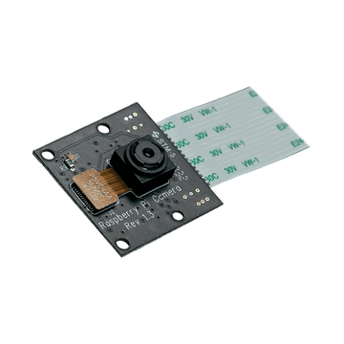








Independent Installation
React Native
firebase cloud
maps api
pi cam
raspberry pi
YOLO V4
open cv
python
Tenserflow

Slide 10






Upgrading Existing Installation
pre- installed cctv
server
cloud

Slide 11
Counting at Places with Limited Entrences
Using UP and Down Method
Cams are fixed facing downwards in Entrences
Result = People entered -people left

Slide 12
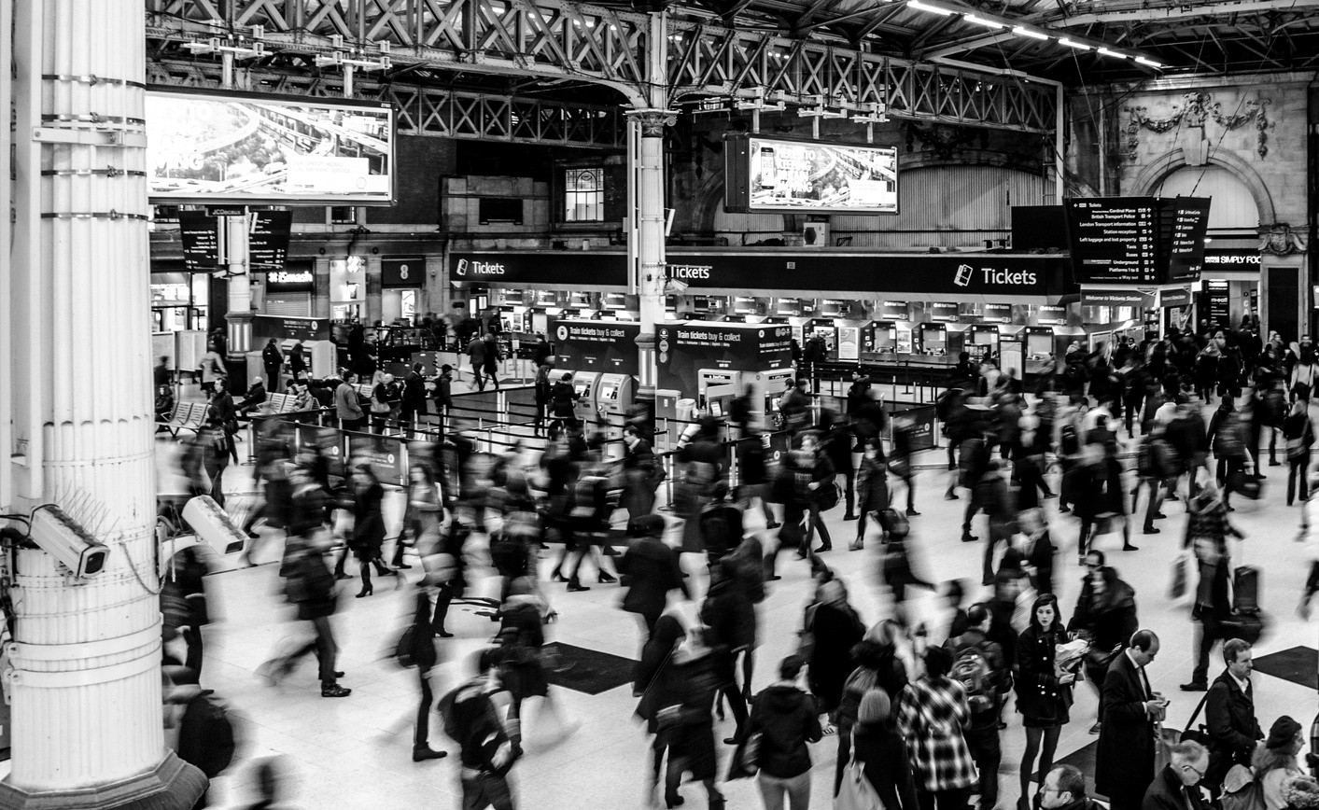
Counting at Open Spaces
Cams are placed to get the whole view of the place
Result = No. of People on the Screen

Slide 13




PROCESS VIDEO
Raspberry PI do the counting process with the help of OPEN CV and send the data into firebase cloud.
WORKING PROCESS
SHOWS COUNT IN APP
The Crowd Vision App receives the counting data from the cloud. Live Counting of people is dispalyed in the application.

Slide 14






Significant Features
Future Crowd prediction
The number of people at the respective places will the predicted and shown by using ARIMA and SIRIMAX
Multi-lingual
Multiple Regional Language support for the user.
Multi-platform
App is supported in all platforms
Budget Planner
Provide people the perfect place to spend their vacation also within a limited budget.
Crime rating
We provide crime rating and analysis of a particular area for the customer for a safe and sound journey.
Customer Review
We allow customers to rate their place of stay and travel experience to get better user benifits.
Near by accommodation
We Provide near by accommodation to our customers by auto suggestion.

Slide 15

Integrating our application
Admin can be use our app to sell their service ( such as Booking, Buying Products, more ) with minimum percent as service charge to gain money.

Slide 16

BUSINESS MODEL
Future Scope of the Project

Slide 17


Travel
Events & Organisation
By Using Ticket Number Shows The Recommended Routes
Our budget planner provides you the perfect vacation within your given budget limit
CCTV cameras, In which Raspberry PI is installed with OPEN CV, records the crowd count and shows in our companion application.

Slide 18
END

